Slide 1
The Essence of Leadership
Leslye M. Fraser
AAFEA National President
March 9, 2017

Slide 2
Webcast Objectives
Identify methods, strategies and advice for a successful SES career
Provide an understanding of:
The power of influence
Identifying organizational culture; and
How to provoke positive change and innovation

Slide 3
What Do Agencies Want in an SES Candidate?
U.S. Office of Personnel Management
“As we move into the 21st century, Government executives face special challenges . . .
They must be visionary leaders with a strong commitment to public service

Slide 4
What Do Agencies Want in an SES Candidate?
They must be able to apply “people skills” to motivate their employees, build partnerships, and communicate with their customers
Finally, they need solid management skills in order to produce optimum results with limited resources.” Guide to Senior Executive Service Qualifications, http://www.opm.gov/ses/pdf/SESGUIDE2.pdf

Slide 5
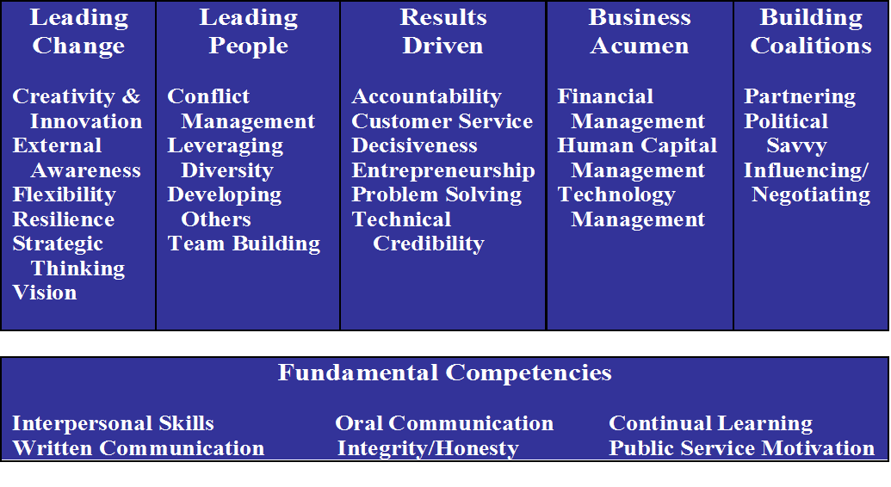
OPM: 5 SES ECQs

Slide 6
The Essence of Leadership
The ability to understand and utilize your innate talents and to also effectively leverage the natural strengths of your team to accomplish the mission.
Leadership should be the humble, authentic expression of your unique personality in pursuit of bettering whatever environment you are in.
Katie Christy, Founder, Activate Your Talent

Slide 7
Keys to Successful Leadership
Do you know yourself?
Do you know your organization?
Are you politically savvy?

Slide 8
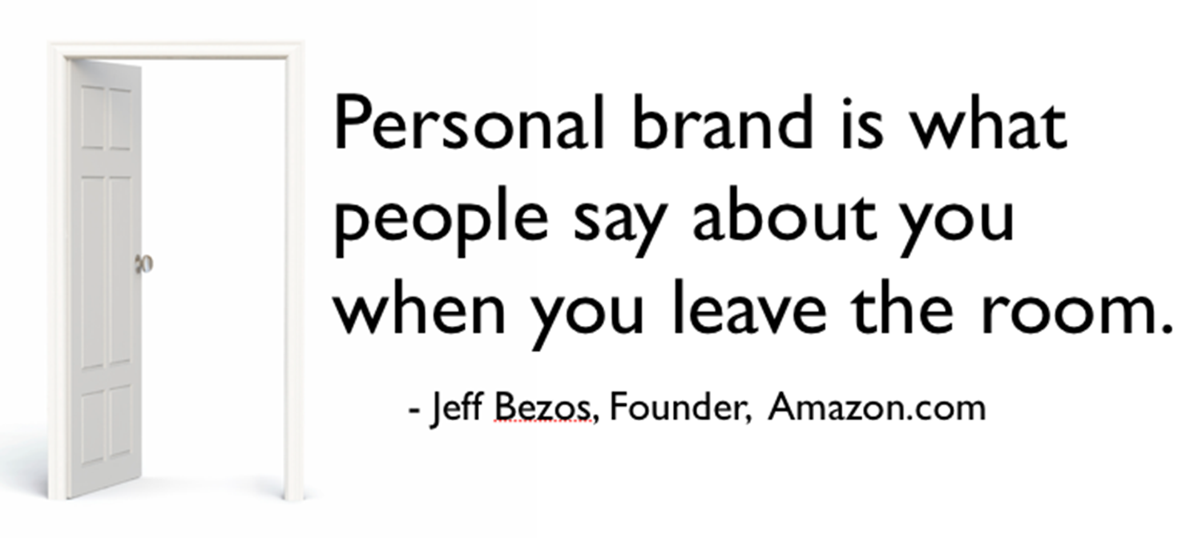
What’s Your Personal Brand?

Slide 9
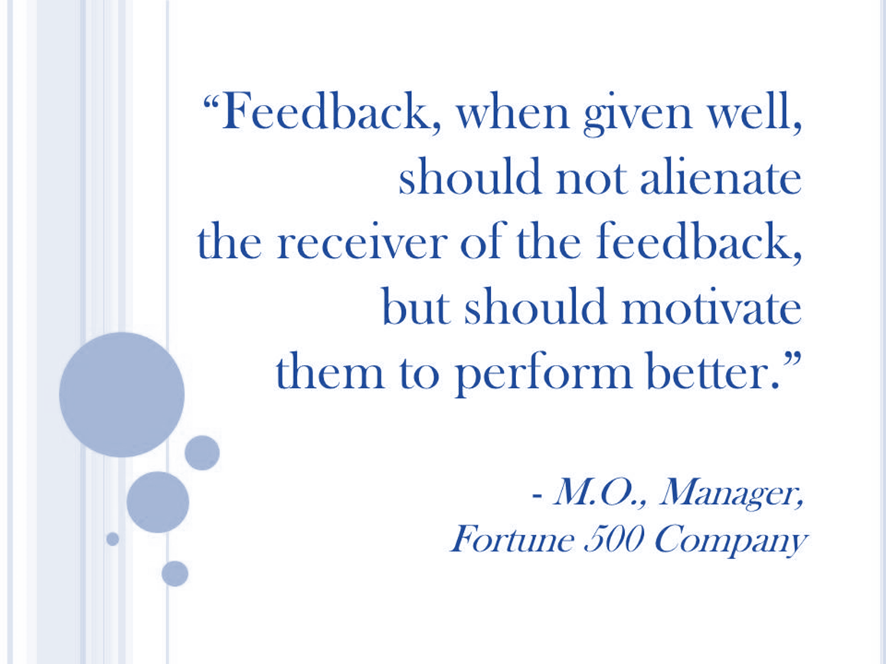
Self-Assessment Tools
Traditional 360 – often used in professional settings
Anonymous input from peers, direct reports, customers, etc., and your supervisor
Third Party Validation of Your Personal Brand
Myers-Briggs Personality Assessment Tool
Important Corollary: Don’t ask for feedback if you can’t/won’t receive it with grace!

Slide 10
Self Assessment Tools: Myers-Briggs
The Myers–Briggs Type Indicator (MBTI) - based on your self-reported answers to a questionnaire indicates:
How you perceive the world and make decisions
Your strengths and weaknesses, including how you are perceived by others
16 personality types; none better than another – all have strengths and weaknesses
See e.g., www.16personalities.com (12 minute free “test”)

Slide 11
MBTI Personality Indicators

Slide 12
16 Personality Types
Four Myers-Briggs “Personality Type” Groups
Analysts (INTJ, INTP, ENTJ, ENTP) – embrace rationality and impartiality; fiercely independent, open-minded, strong-willed and imaginative, and more interested in what works than what satisfies everybody.
Diplomats (INFJ, INFP, ENFJ, ENFP) – cooperative, empathic and imaginative, focus on morality and cooperation
Sentinels (ISTJ, ISFJ, ESTJ, ESFJ) – highly practical, meticulous and traditional, embracing and creating order, security and stability wherever they go
Explorers (ISFP, ISFP, ESTP, ESFP) – spontaneous, practical and inventive, think quickly on their feet and make the best use of their surroundings

Slide 13
Can Use Your MB Results to Understand…
What behaviors are overdone and overlooked
Your strengths and your growth opportunities
Your impact on others and how they perceive you
Your work colleagues and how to understand, motivate, and communicate better with them

Slide 14
ISTJ as a Manager
MBTI Workplace Example
Able and willing to make difficult decisions
Like making rules/structure; strongly opposed to breaking rules
Live by the “only the facts, please” motto
Love responsibility and the power resulting from it
Very intolerant of their staff members’ failures to meet their obligations
Don’t like being criticized
Believe that truth is more important than sensitivity
Expect their subordinates to go above and beyond their duties, but may forget to praise them (ISTJs treat themselves the same way)
May dislike changes and innovations

Slide 15
ENTP as a Staff Member
Comfortable challenging management’s ideas
Curious and able to learn new methods very quickly
Strongly dislike restrictive rules and guidelines
Prefer complex challenges over dealing with simple routine tasks
Do not mind being criticized, as long as all arguments are rational
May have difficulties with practical or monotonous tasks

Slide 16
Dealing With Your Weaknesses/Blindspots
Self-help
What Got You Here Won’t Get You There by Marshall Goldsmith
FYI For Your Improvement by Michael Lombardo and Robert Eichinger
How to Win Friends and Influence Enemies by Dale Carnegie
Read articles on www.16personalities.com for your MB Type
Float your vision/ideas with others, not just your cheerleaders
Find a buddy who can discretely signal you when you are going blind

Slide 17
KNOWING THE ORGANIZATION

Slide 18
Do You Know the Organization?
Talent/skills alone are not sufficient
You need to know:
Rules of the game (general)
Culture of the team (specific)
Team’s play book (specific)

Slide 19
Knowing the Organization
First Day on New Job as Senior Leader
Assess changes as you change position and/or organization
What’s different?
Office culture
Office politics
Agenda/mission
Goals and objectives
Values

Slide 20
Office Culture
Dress
What/who are the drivers for agency/office’s mission?
Flexiplace/telework/core hours
LIFO (last in/first out)
How much do you share about yourself?

Slide 21
Know What Drives Your Organization
President’s and/or Agency Head’s Priorities
Stakeholder Views
(e.g., Congress, State/Local Govts, Industry, Community and/or Public Interest Groups)
Timing
Policy
Decision
Economic Analyses
Legal Authority
Executive Orders, Department directives, etc.
Budget
[Sound scientific basis]

Slide 22
Learning the Organization
Know key officials by name and face
15 second elevator speech
Network – connect with influential people; observe how they behave and carry themselves in meetings
Find a mentor who can help educate you on what drives your agency and office
Scan your environment – pay attention to posture, non-verbal cues; consider what is driving others and how they advance their position
Understand what drives your agency and your boss

Slide 23
Learning the Organization
Read
Newspapers, books and other publications with comprehensive political analyses to learn/understand opposing viewpoints on issues
Trade magazines re: your agency
Your agency website’s highlights each morning when you log in
Listen/watch radio/TV programs that cover political issues
CSPAN when your agency testifies before Congress; budget hearings

Slide 24
Office Politics
X
Often perceived as a self-serving way to promote personal interests – often at the expense of others (win-lose)
How power, influence, and interests play out in an organization
Office politics is “simply the way things really get done around here”
Limelight leadership vs. behind the scenes leadership

Slide 25
Political Savvy Managers …
View workplace politics as neutral (not good, not bad); it’s simply a natural part of life in virtually all organizations
Understand and utilize the dynamics of power, organization, and decision-making to achieve win-win objectives
Use ethical strategies, cultivate relationships and establish their brand as a professional, team player and leader
Authentically use their skills, behaviors, and qualities to be most effective

Slide 26
Some Strategies for Provoking Positive Change

Slide 27
Change vs. Transition
Change is situational
Transition is a psychological process
Organizations often develop elaborate change strategies for things they want to change
Organizations often pay inadequate attention to implementation strategies that help people through the process of adjustment
William Bridges, 1993
Notes:
If you want to lead successfully in times of change, you will have to help people through the process of change that your vision implies. We want to share some helpful ideas on managing change from William Bridges. Bridges distinguishes between “changes” and “transitions.”
Change is an event; transition is a psychological process.
Changes are things that happen in the physical environment: we get a new computer, we move to a new location, our office is restructured, etc.
Transitions are the psychological adjustments we have to make when the world changes around us.
Change is easy to do; transitions are tougher. Often we make plans for managing change in organizations but don’t make implementation plans for managing transitions.

Slide 28
Managing Transitions
(Continuum Graphic by William Bridges, 1993)

Slide 29
Managing Transitions: 3 Phases
ENDINGS
NEUTRAL ZONE
BEGINNINGS
Let go of the past first before embracing the new.
Neither the old ways nor the new ways are working.
The new situation is fully accepted. People are building up skills and seeing success.
Innovation
Anxiety
Creativity
Skepticism
Isolation
Motivation falls
Turnover rises
Uncertainty
Denial
Confusion
Frustration
Reservation
Commitment
High Energy
Learning
Accomplishment
New values, attitude, identities
Notes:
The starting point for dealing with transition is not the outcome, but the ending that you’ll have to make to leave the old situation behind. Need to first manage the “letting go” process. Can’t just focus on “the change makes perfect sense.”
“Faced with the choice between changing one’s mind and proving that there is no need to do, almost everybody gets busy on the proof.” John Kenneth Galbraith, Economist
Denial is the first stage in the grieving process
Many people find it difficult to deal openly with others’ pain.
If you suppress the feelings and push people to get over them, you’ll be handicapped by people who never “mended.”
Never denigrate the pat; you consolidate resistance against the transition because often people associate their self-worth with the way things used to be when the past is attacked. Build on the past!
New challenges call for new responses
Endings occur more easily if people can take a bit of the past with them

Slide 30
Managing Transitions
Neutral zone management isn’t just something nice to do if you had more time;
It’s the only way to ensure the organization comes through the change intact and that the necessary changes actually work the way they are supposed to.

Slide 31
4 Ps of Managing Transition
Notes:
- Purpose: One big obstacle to new beginnings is where people cannot see any discernible purpose behind the proposed changes.
People need to understand where organization stands and what the issues are.
- Picture: Use visual aids to convey the picture of the new way things will be – BUT make it a picture they can identify with, not become intimidated by. Have people visit another office/agency where things are already done in the new way; Don’t expect the picture to have its effect prematurely – that is, before your people have made an ending and let go of the past.
- Plan – outline the steps and schedule in which people will receive the information, training, and support they need to make the transition
- Part to play: If don’t provide this, people will feel left out and have difficulty making a new beginning. Need to give people two parts to play
Their role and their relationship to others in the new scheme of things
Their role in dealing effectively with the transition process itself

Slide 32
4 Ps - Activating Others
Purpose, Picture, Plan, and a Part to play
Myers-Briggs Thinking (“T”) types can be activated by an idea (Purpose)
Intuitive (“N”) MB can be activated by a vision (Picture)
Sensing (“S”) types need a Plan
Feeling (“F”) types need everyone to have a Part in the undertaking

Slide 33
Learn How to Manage Conflicts Well
Your personal brand is important
Are you a team player; trustworthy; authentic in putting the organization first
Get a coach if you need to improve your skills
Don’t overcorrect by avoiding all conflict or constantly trying to smooth things over
Distinguish between interests and positions to find win-win outcomes
Not all compromises are good – people may remember what they lost more than what they gained

Slide 34
Position vs Interest
Issue: subject under discussion; what the problem is that needs to be solved
Position: a person’s proposed solution to an issue, justification, or demand
Interest: a person’s concern, desire, underlying need, motivation, or explanation

Slide 35
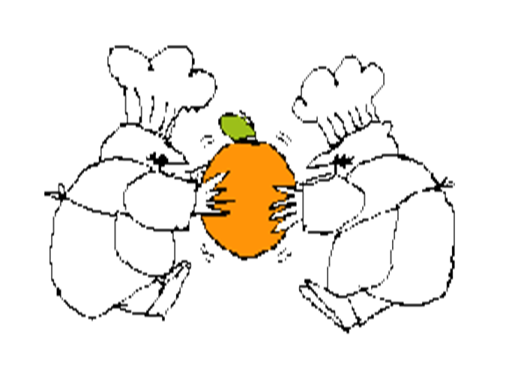
Mediating Two Competing Positions

Slide 36
Position vs. Interest: Basic Mediation Skills
Position
Focuses on a particular solution
Makes a demand
Sets up confrontation before issue is clearly defined
Designed for anticipated bargaining; compromise
Interest
Focuses on the problem
States one of a range of needs
Establishes a climate & common language for discussion so real issue can be understood and discussed

Slide 37
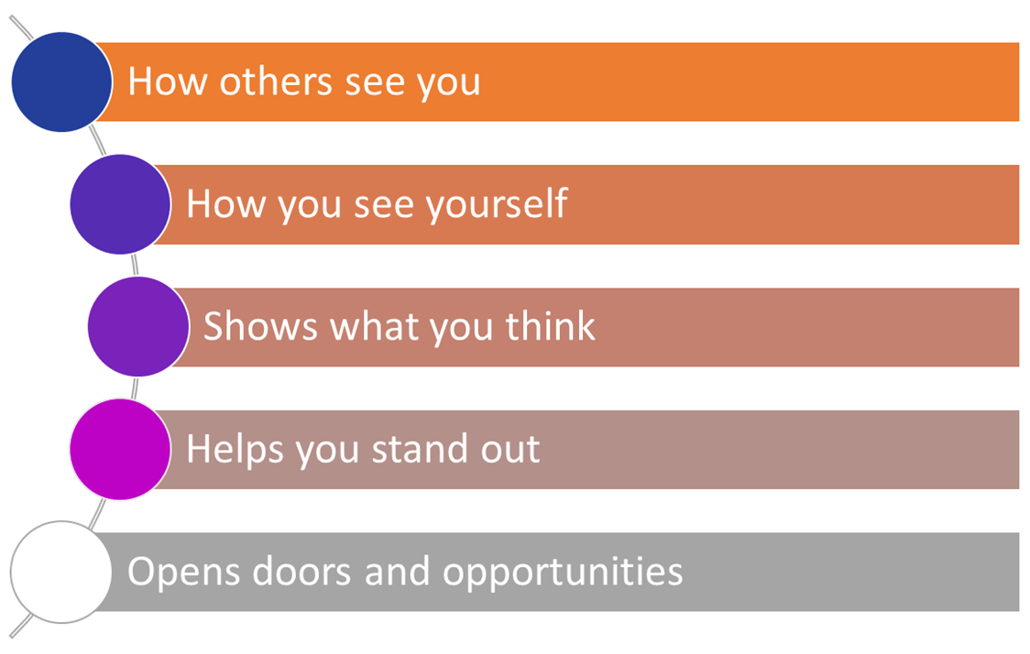
In Summary ….
The Essence of Leadership

